Slide 1

Path Planning
COMSM4111 Robotic Systems
Anonymous Feedback form:
https://forms.gle/PyQQy2mwzyATFmJW6
Padlet board (questions & comments):
http://padlet.com/paul_odowd1/1lhoodwv2fuc
Delivered by:
Paul O’Dowd paul.odowd@bristol.ac.uk

Slide 2
House Keeping
Assessment Opportunity 2 – currently 43 people booked in.
You’ll need to have your code ready to:
Show a TA
Email to paul.odowd@bristol.ac.uk
Upload to your Romi
Please wait in the Bill Brown lobby area until you are called in.
Please do not use External Libraries
You’re not marked for the standard of your code.
I’m attending MVB 1.11 5-6pm.
I’ll be giving a talk on my career / research, 14th November 5-6pm

Slide 3
Lab Sessions / Sheets
Week 1
Week 2
Week 3
Week 4
Week 5
Week 6
Week 7
Meet the Romi
Millis()
Encoders
PID
Line Following
Finite State Machine
Motors
Time & Speed
Kinematics
Lectures
Intro
Sensors & Actuators
Feedback Control 2
Probabilistic Robotics
System
Architectures
Path Planning
Experimental Robotics
Micro-controllers
Feedback Control 1
Kinematics
PID Drop-In
Sensor Fusion
Searching & Mapping
Toward
Assessment 2
Assessment Op 1
Assessment Op 2
Assessment Op 3

Slide 4
This Lecture: Path Planning
Experiment within the theme of Mapping
Configuration Space / Working Space
Grids vs. Graphs
Grids
Graphs

Slide 5
Experiment within the theme of Mapping

Slide 6
Rationale
Experimental
Method
Key
Implementation
Characteristics
Hypothesis
Experiment 1
(baseline)
Experiment 2
(comparison)
(demo)
Area of Improvement
Results, Discussion, Evaluation
Write a Report:
Using mapping performance as a key context/metric

Slide 7
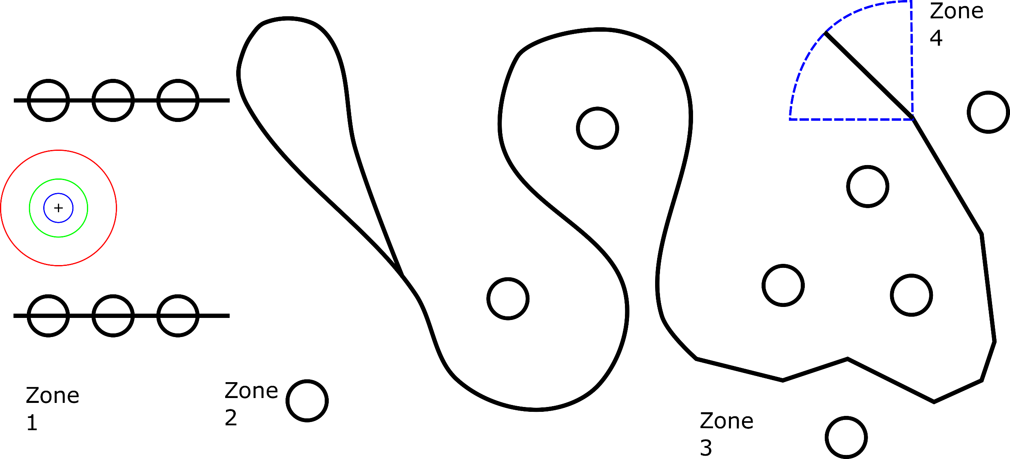
Theme of Mapping:
“path planning” was solved.
All marks are features
You may want to populate these with physical obstacles.

Slide 8
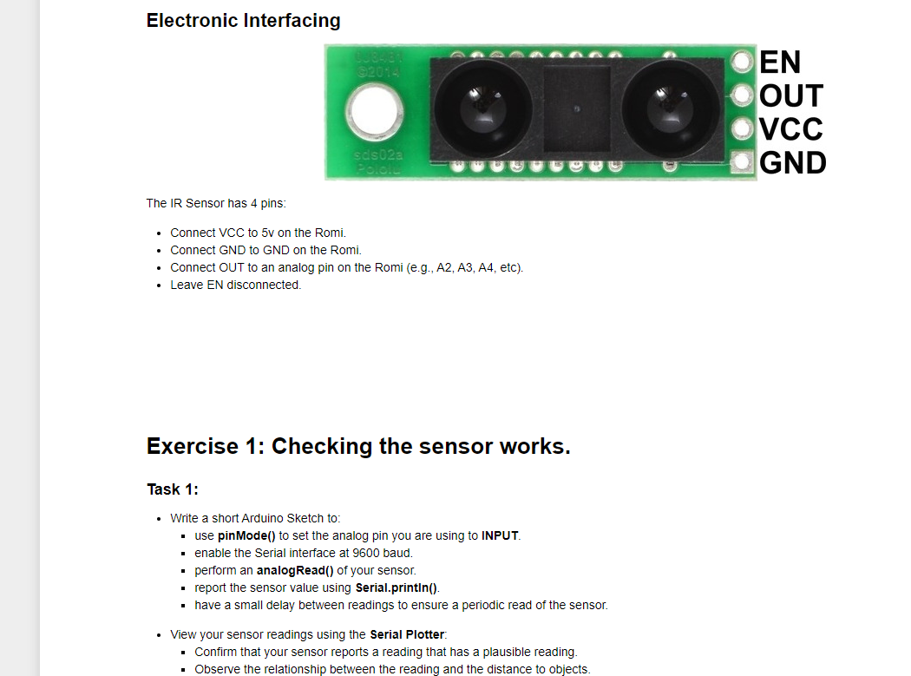
Advanced Labsheet: IR Proximity Sensor

Slide 9
This Lecture: Path Planning
Experiment within the theme of Mapping
Configuration Space / Working Space
Grids vs. Graphs
Grids
Graphs

Slide 10
Configuration Space / Working Space

Slide 11
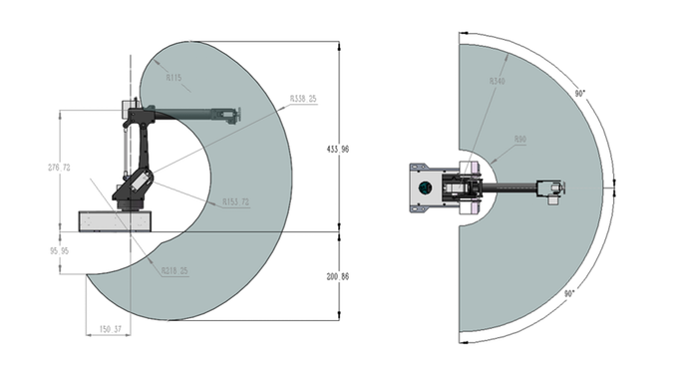
Configuration Space / Working Space
(external, exteroceptive)
Envelope of possible operational space
(internal, proprioceptive)
Range of Joint Positions

Slide 12
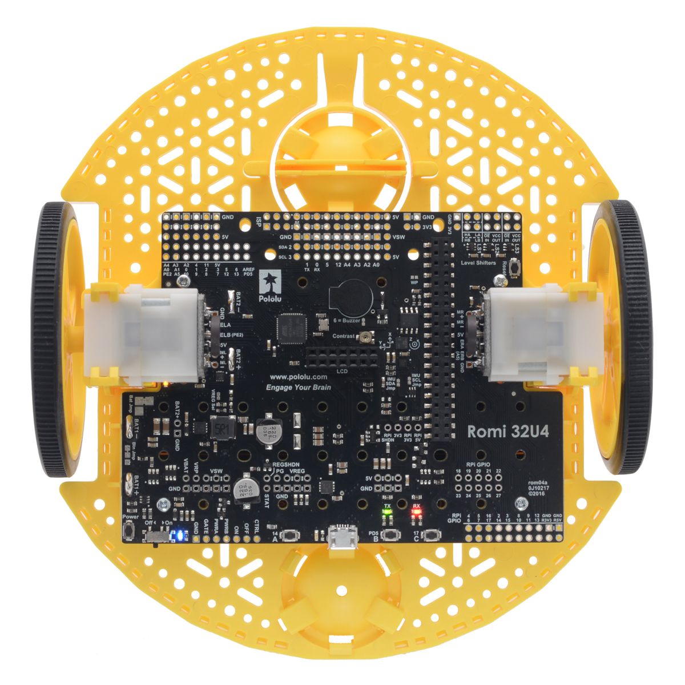
Configuration Space / Working Space
A Reactive control strategy.
No explicit representation of robot or obstacle.
No planning.
Bug Algorithms (heuristics).
?

Slide 13
Configuration Space / Working Space
From our kinematics, we represent our robot as a single point at location x,y, with an orientation θ, and with a radius r.
x, y, θ, r

Slide 14
Configuration Space / Working Space
Obstacle ‘centroid’ isn’t so useful.
We don’t want to collide with the perimeter of this obstacle.
x, y, θ, r

Slide 15
Configuration Space / Working Space
Convex Hull, distance r from perimeter.
x, y, θ, r

Slide 16
Configuration Space / Working Space
x, y, θ, r

Slide 17
Configuration Space / Working Space
?
x, y, θ, r

Slide 18
This Lecture: Path Planning
Experiment within the theme of Mapping
Configuration Space / Working Space
Grids vs. Graphs
Grids
Graphs

Slide 19
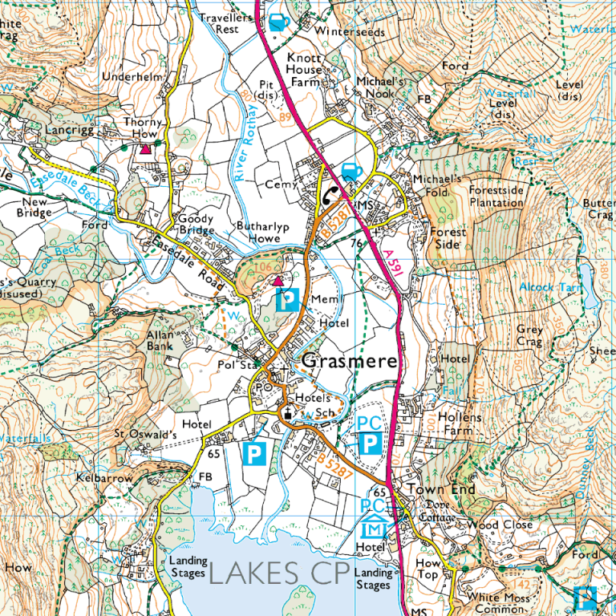
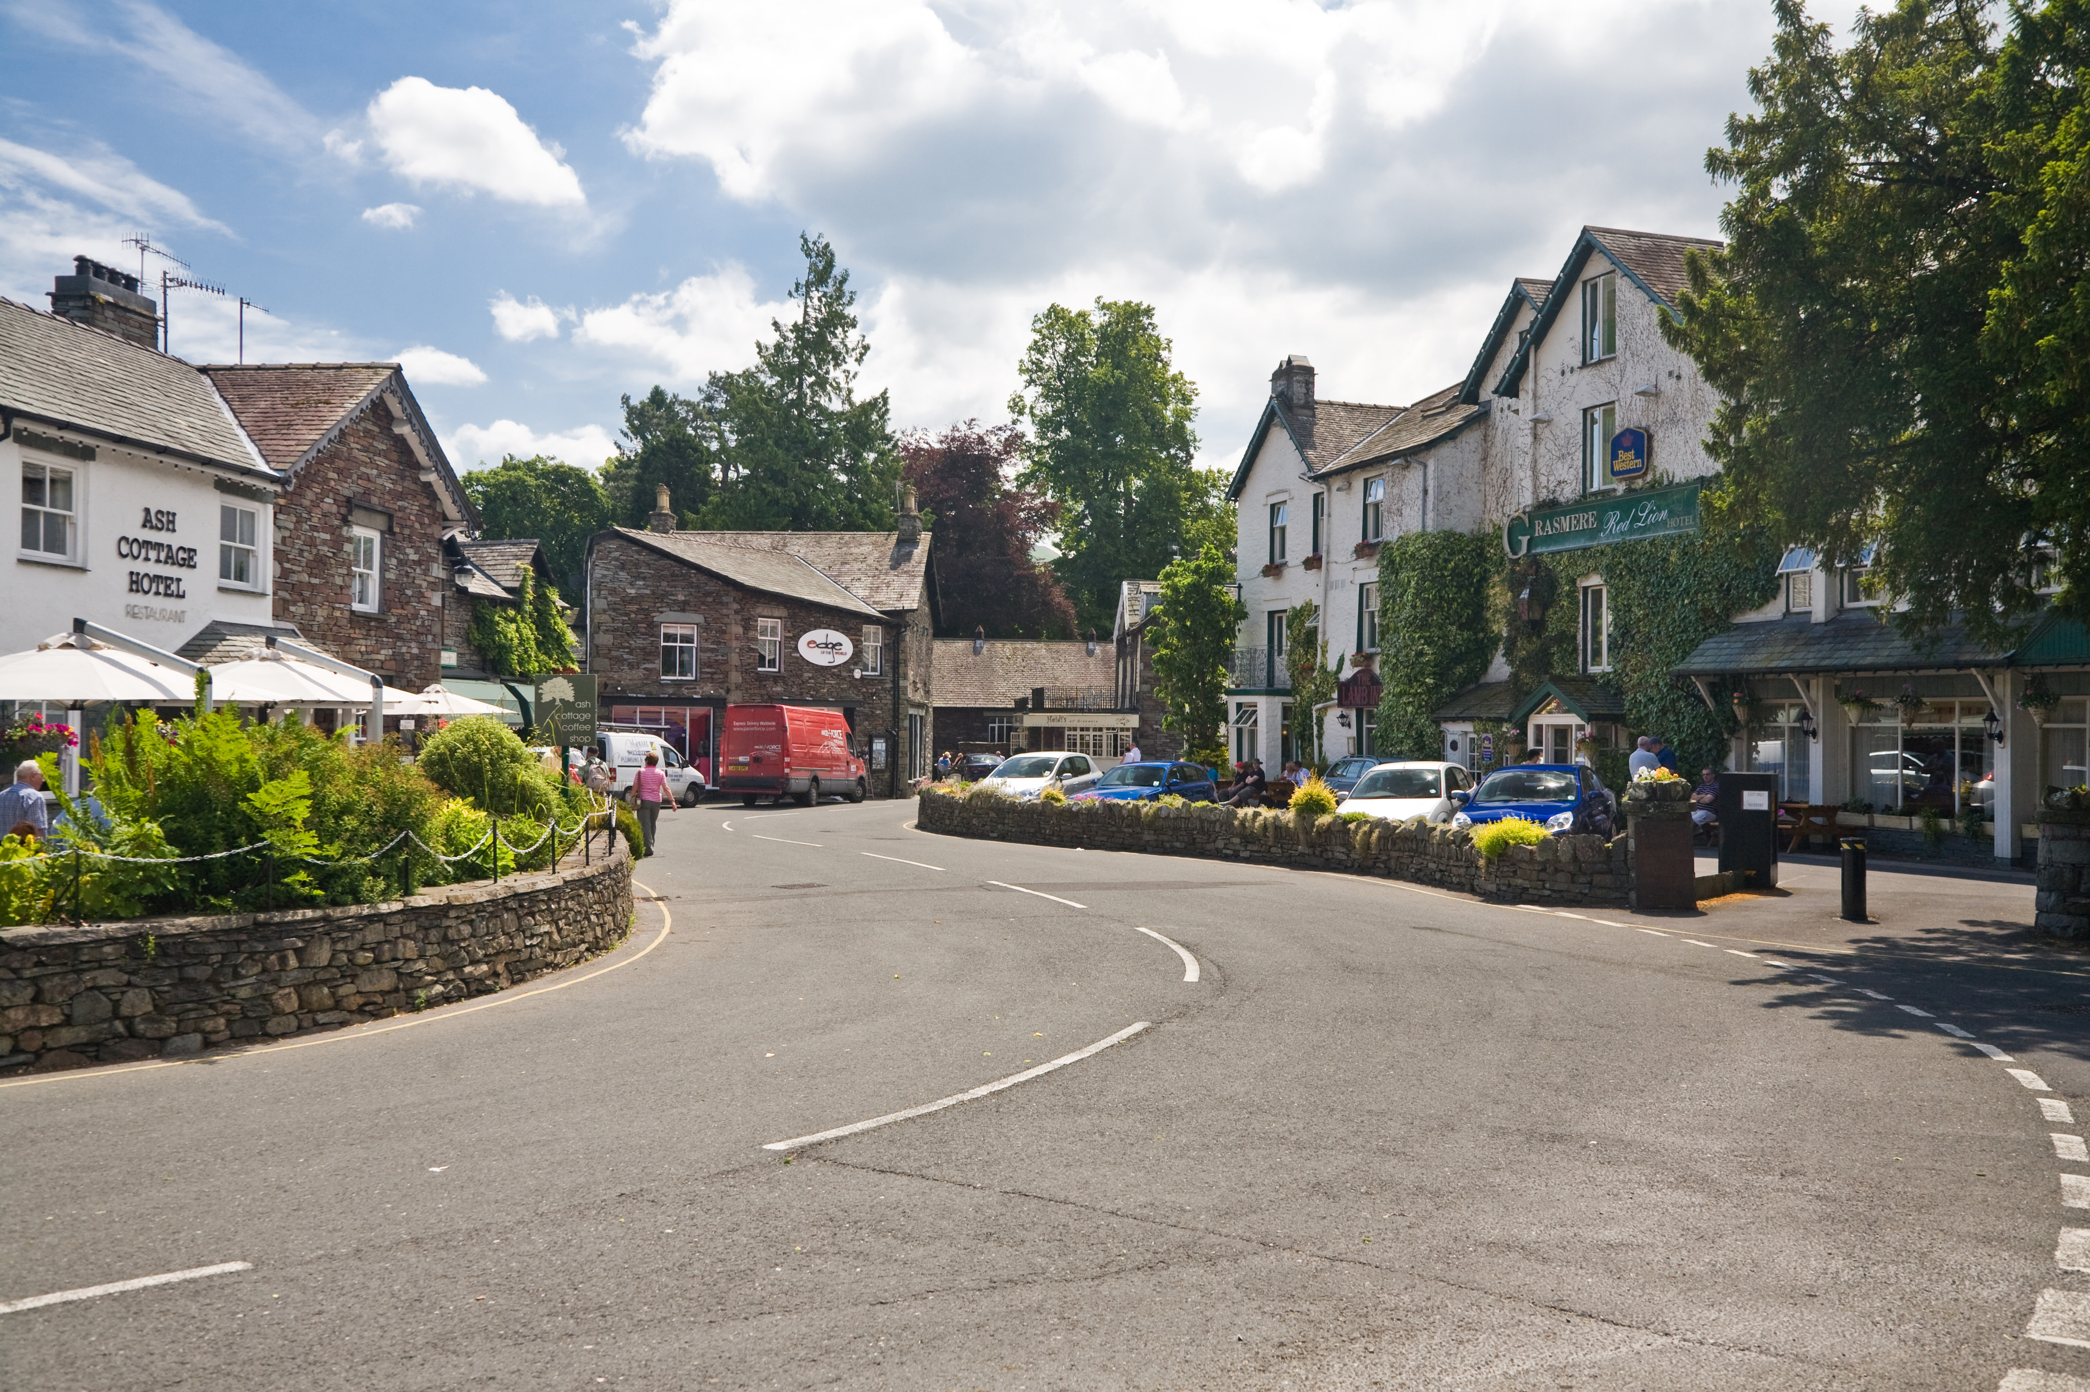
Grids (Metric) vs. Graphs (Topographical)

Slide 20
Grids (Metric) vs. Graphs (Topographical)

Slide 21
This Lecture: Path Planning
Experiment within the theme of Mapping
Configuration Space / Working Space
Grids vs. Graphs
Grids
Graphs

Slide 22
Grids (Metric)

Slide 23
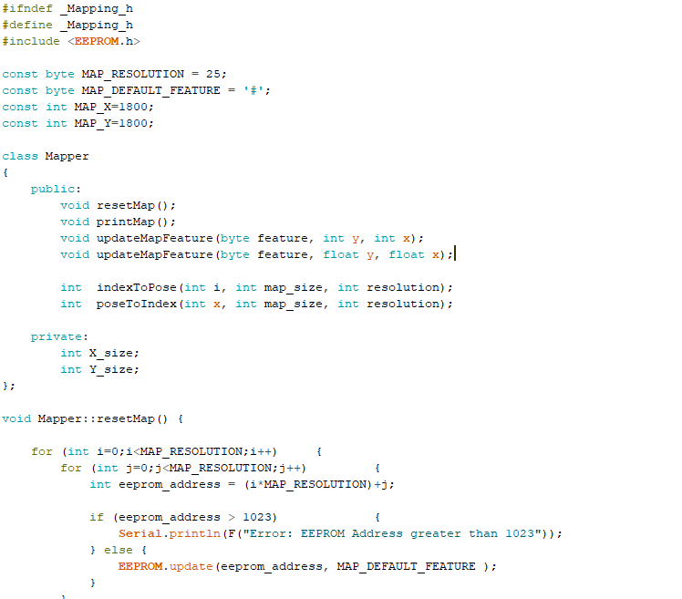
Grids: Mapping Class
########################
########################
###########L############
###########L############
###########L############
###########L############
###########L############
########################
########################
########################
########################
########################
########################
########################
########################
########################

Slide 24
Grids: Resolution

Slide 25
Grids: Resolution

Slide 26
Grids: Object Characterisation

Slide 27
Grids: Updating, Noise / Uncertainty
?

Slide 28
Path Planning with Grids

Slide 29
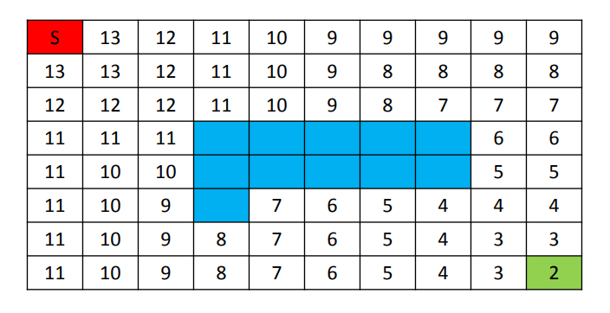
Path Planning with Grids: Wavefront

Slide 30
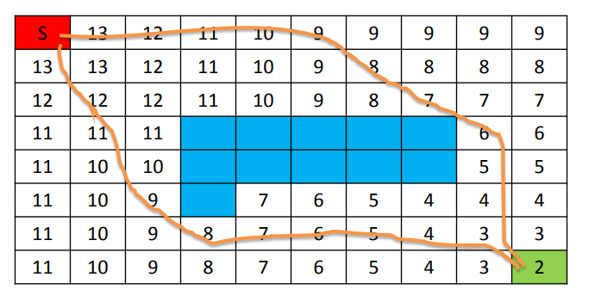
Path Planning with Grids: Wavefront

Slide 31
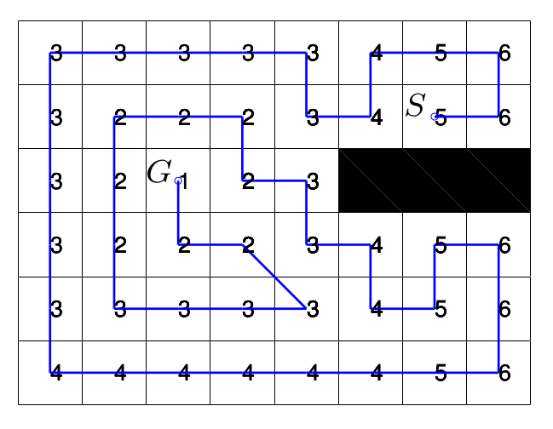
Path Planning with Grids: Wavefront

Slide 32
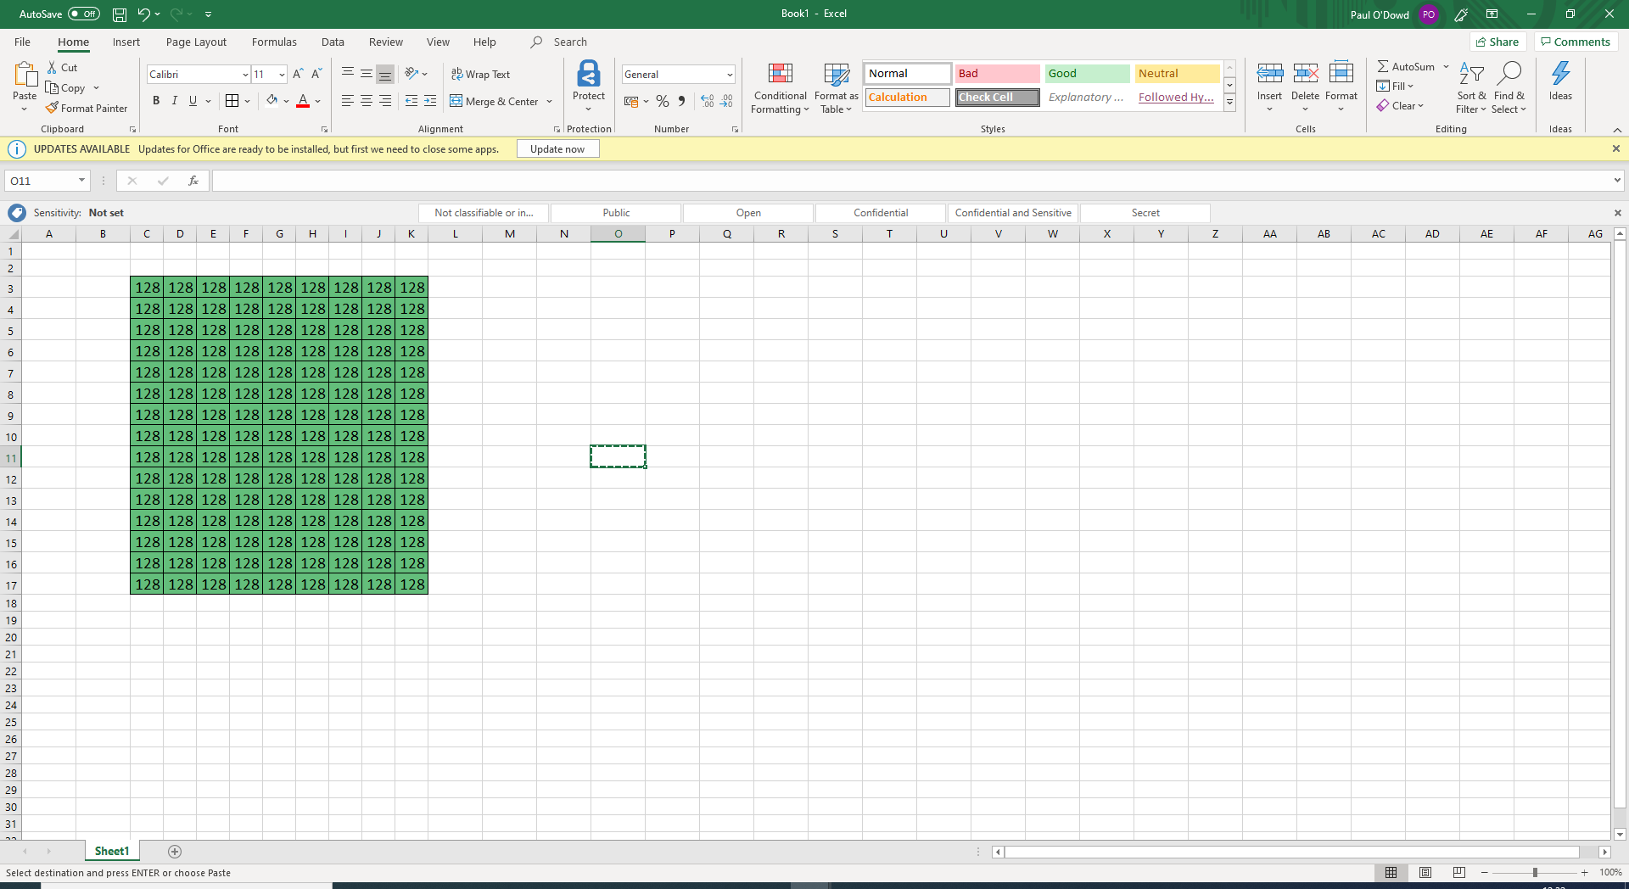
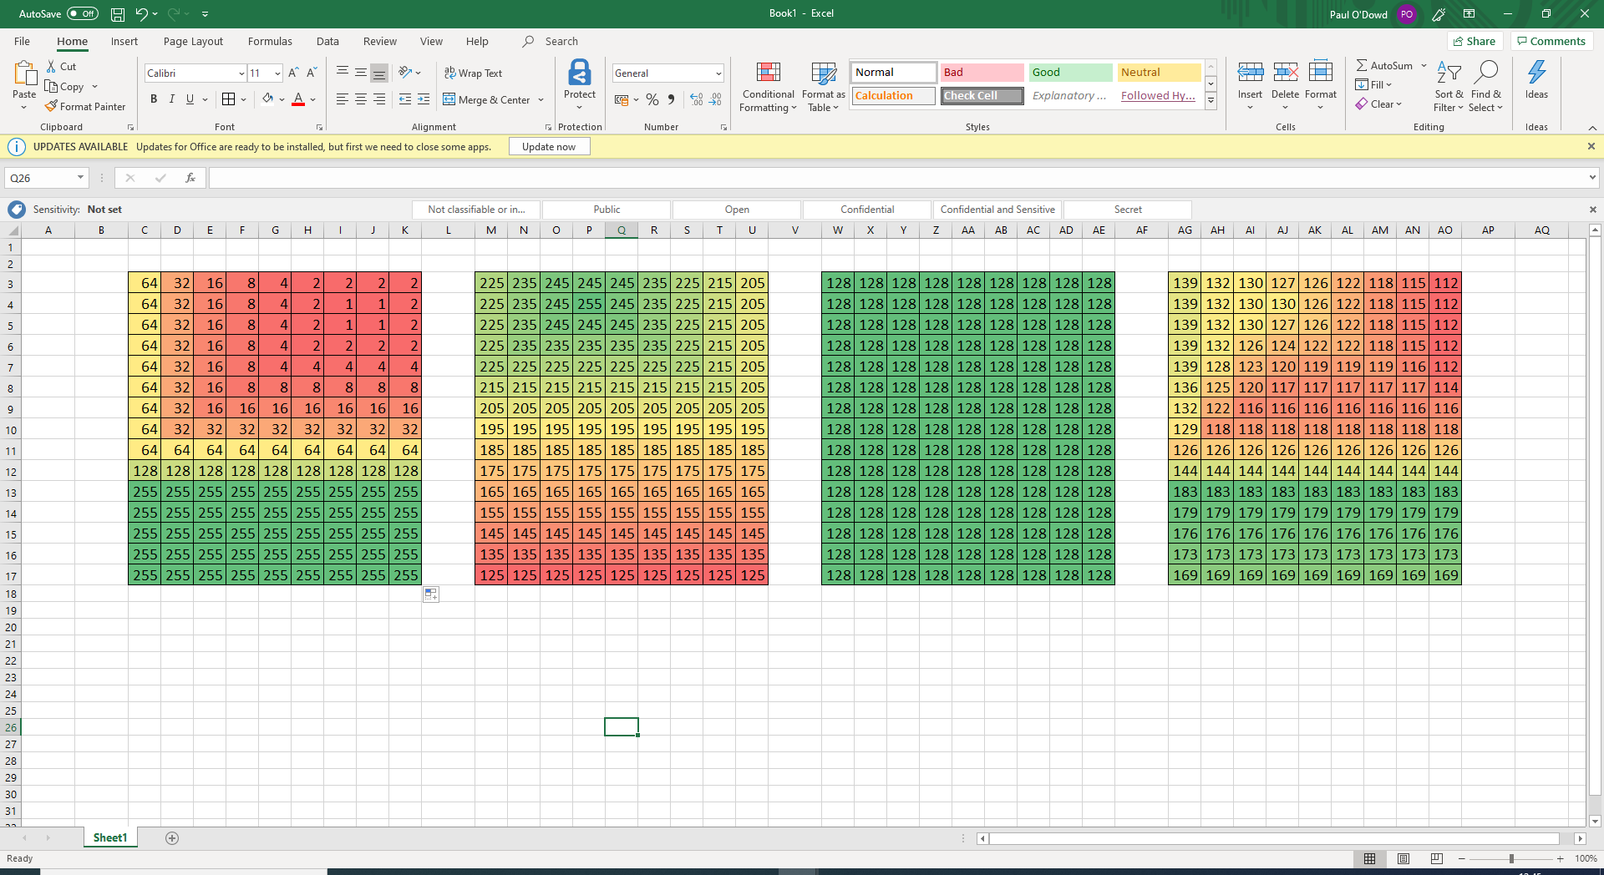
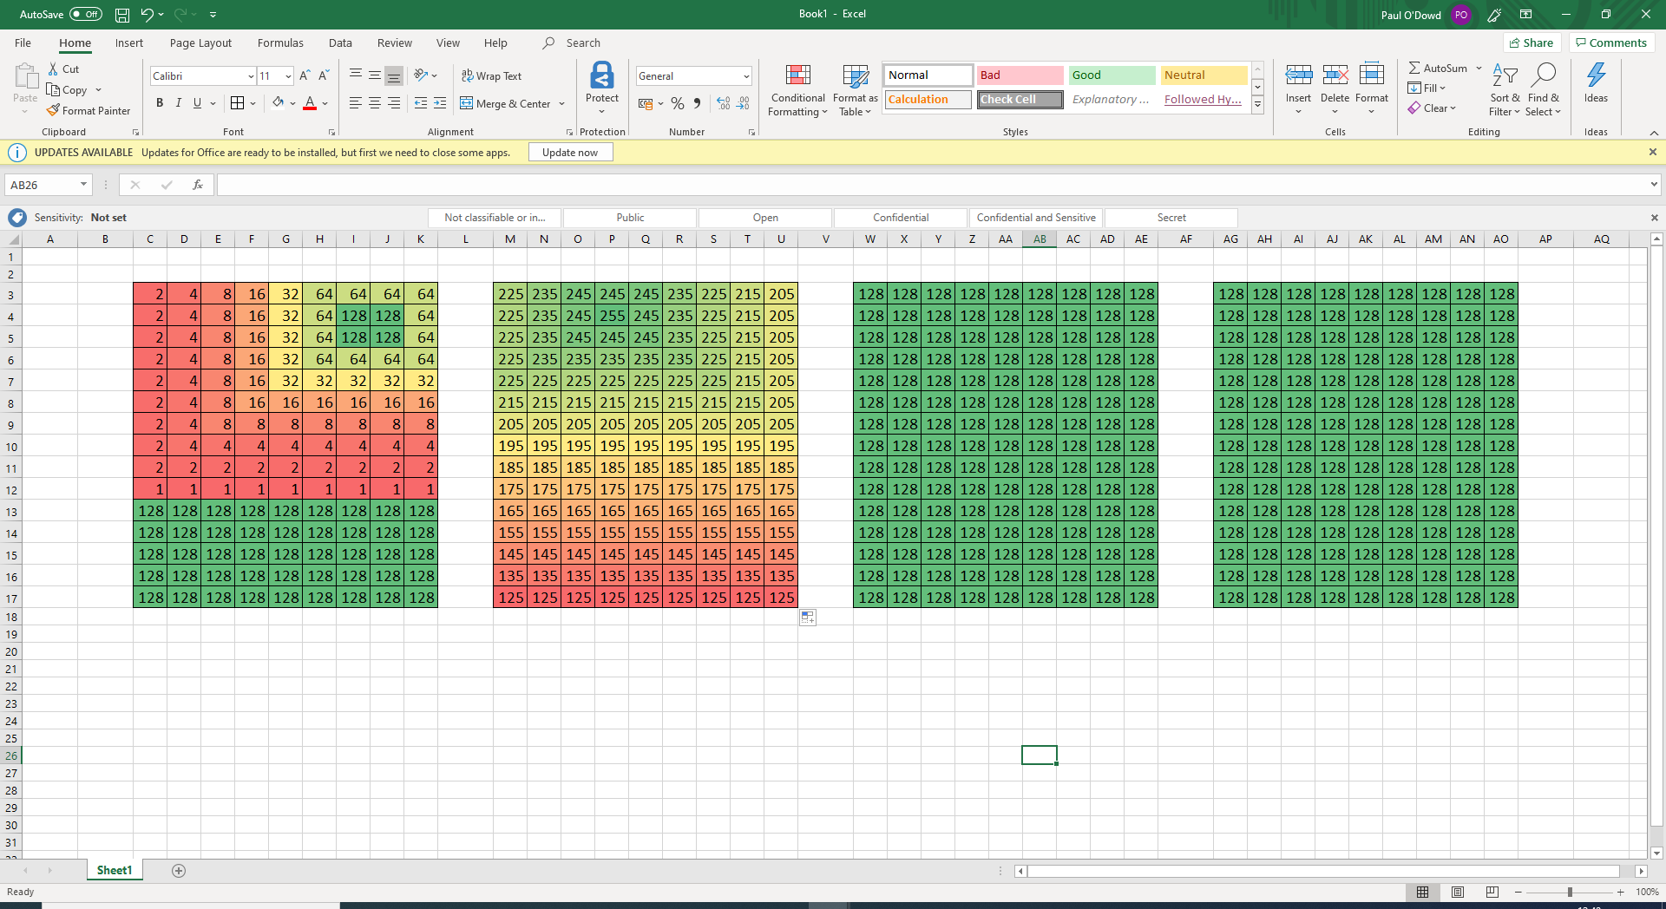
Path Planning with Grids: Potential Fields
Baseline
Repulsors (obstacles)
Attractors (goals)

Slide 33
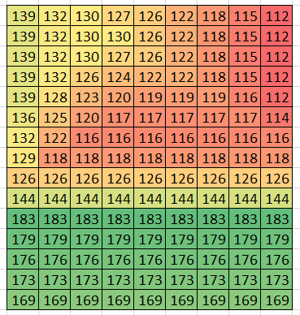
Path Planning with Grids: Potential Fields
You can combine a Deliberative
mapping system with a Reactive control system.
Map can be used as a ‘virtual sensor’ for navigation.

Slide 34
Potential Fields / Flow Fields
https://www.youtube.com/watch?v=bovlsENv1g4
http://www.gameaipro.com/GameAIPro/GameAIPro_Chapter23_Crowd_Pathfinding_and_Steering_Using_Flow_Field_Tiles.pdf
http://grail.cs.washington.edu/projects/crowd-flows/continuum-crowds.pdf

Slide 35
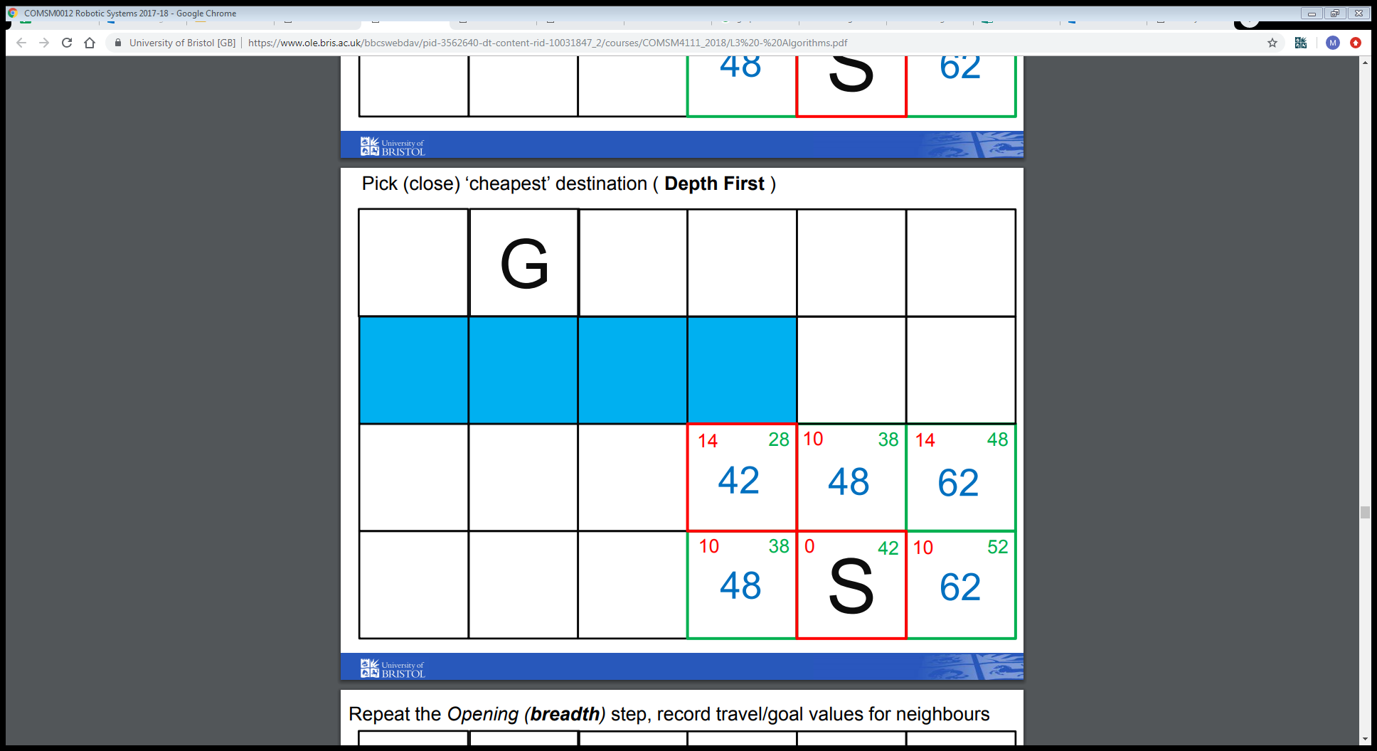
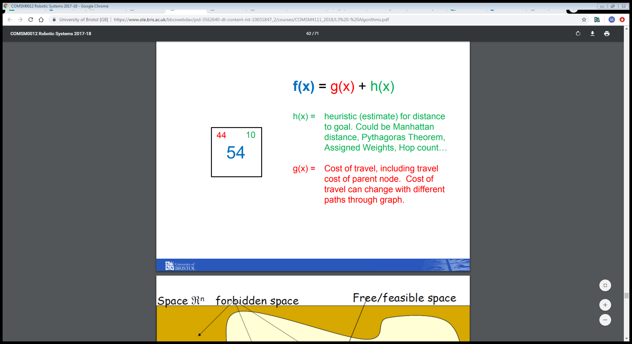
Path Planning with Grids: Search Trees
Breadth-first-search
Search nodes close to start first
Depth-first-search
Search nodes furthest from start first
A*

Slide 36
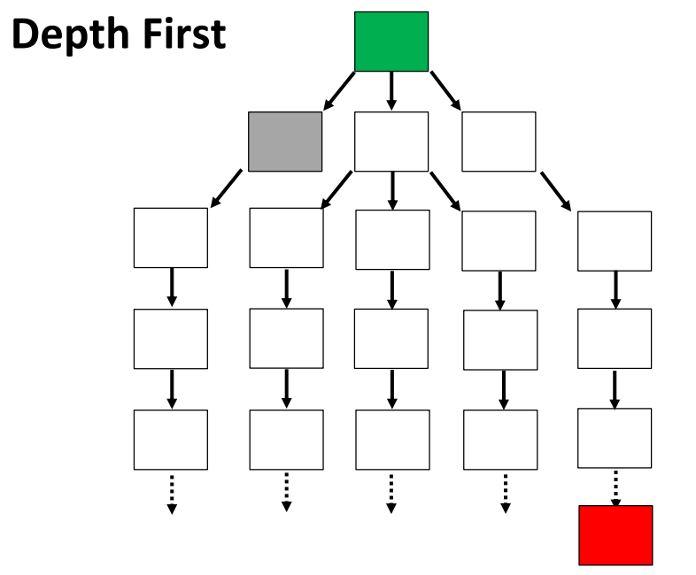
Path Planning with Grids: Search Trees
Breadth-first-search
Search nodes close to start first
Depth-first-search
Search nodes furthest from start first
A*, Dijkstra's algorithm

Slide 37
This Lecture: Path Planning
Experiment within the theme of Mapping
Configuration Space / Working Space
Grids vs. Graphs
Grids
Graphs

Slide 38
Graphs (Topographical)

Slide 39
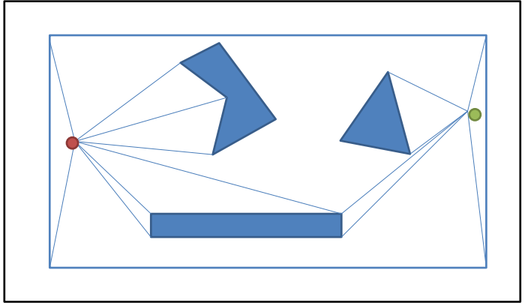
Visibility Graphs

Slide 40
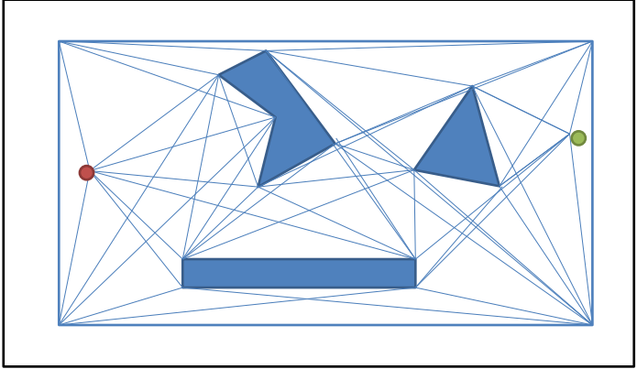
Visibility Graphs

Slide 41
Visibility Graphs

Slide 42
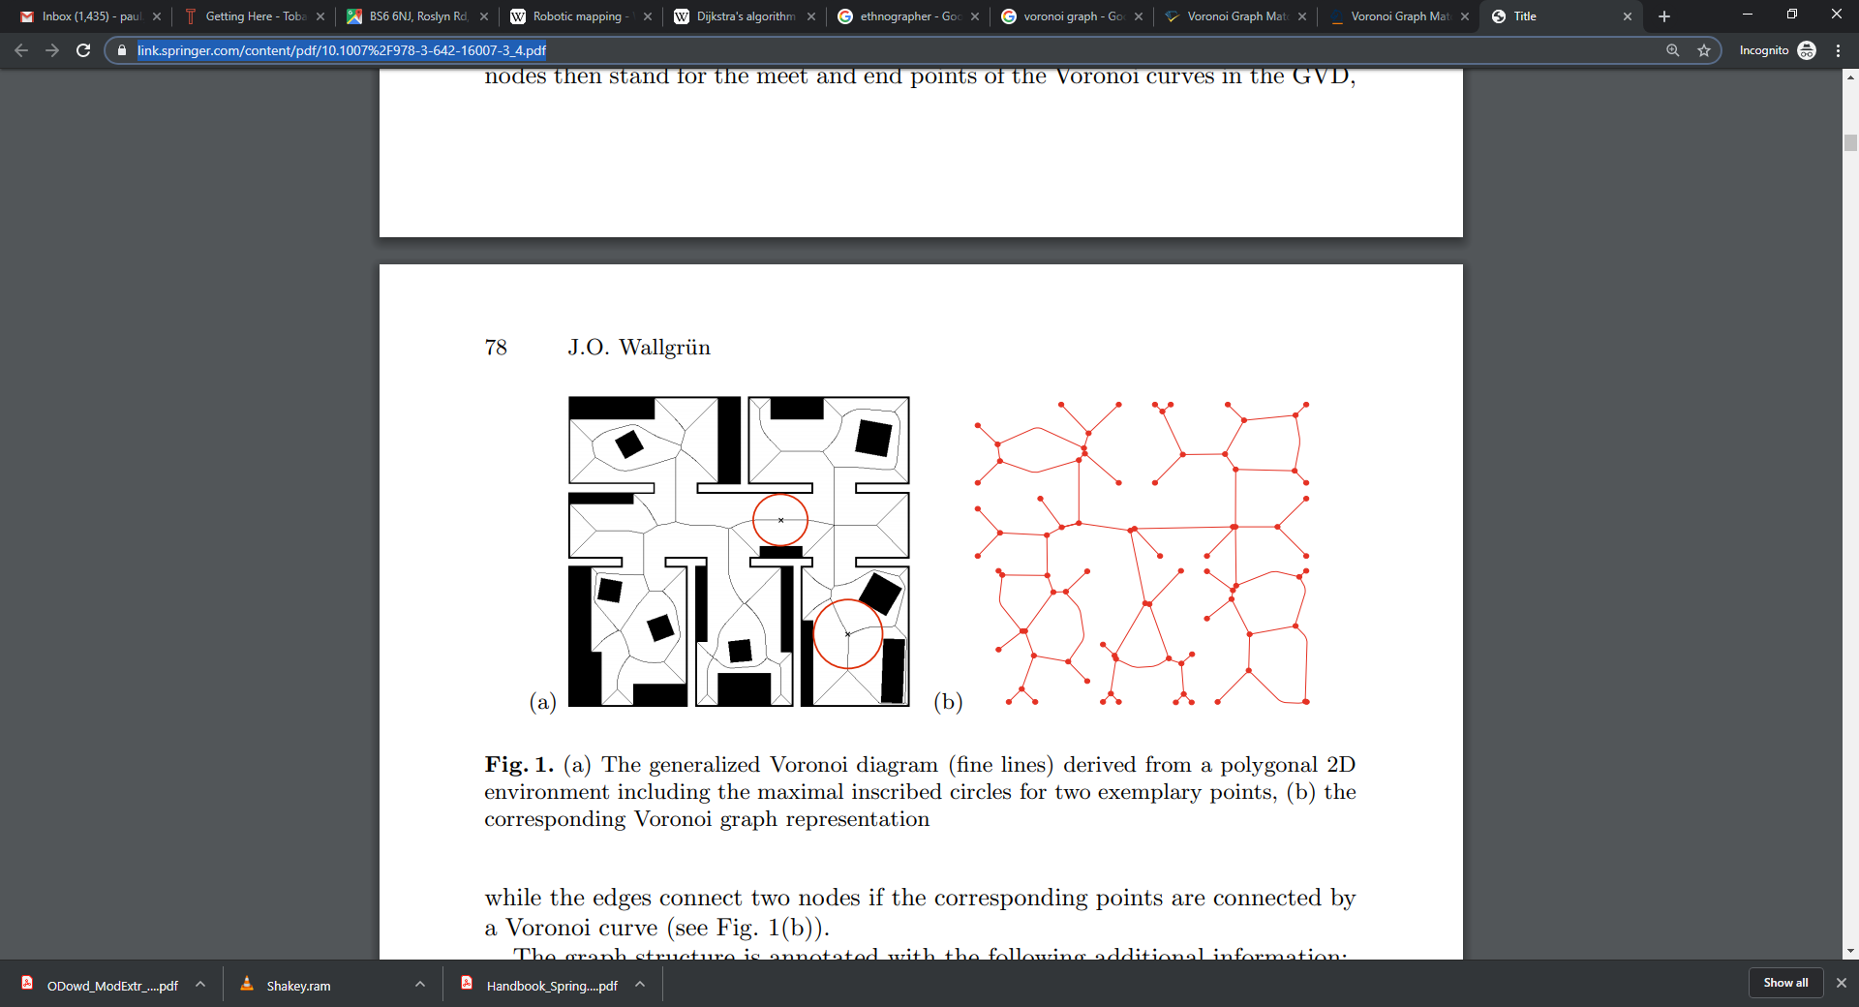
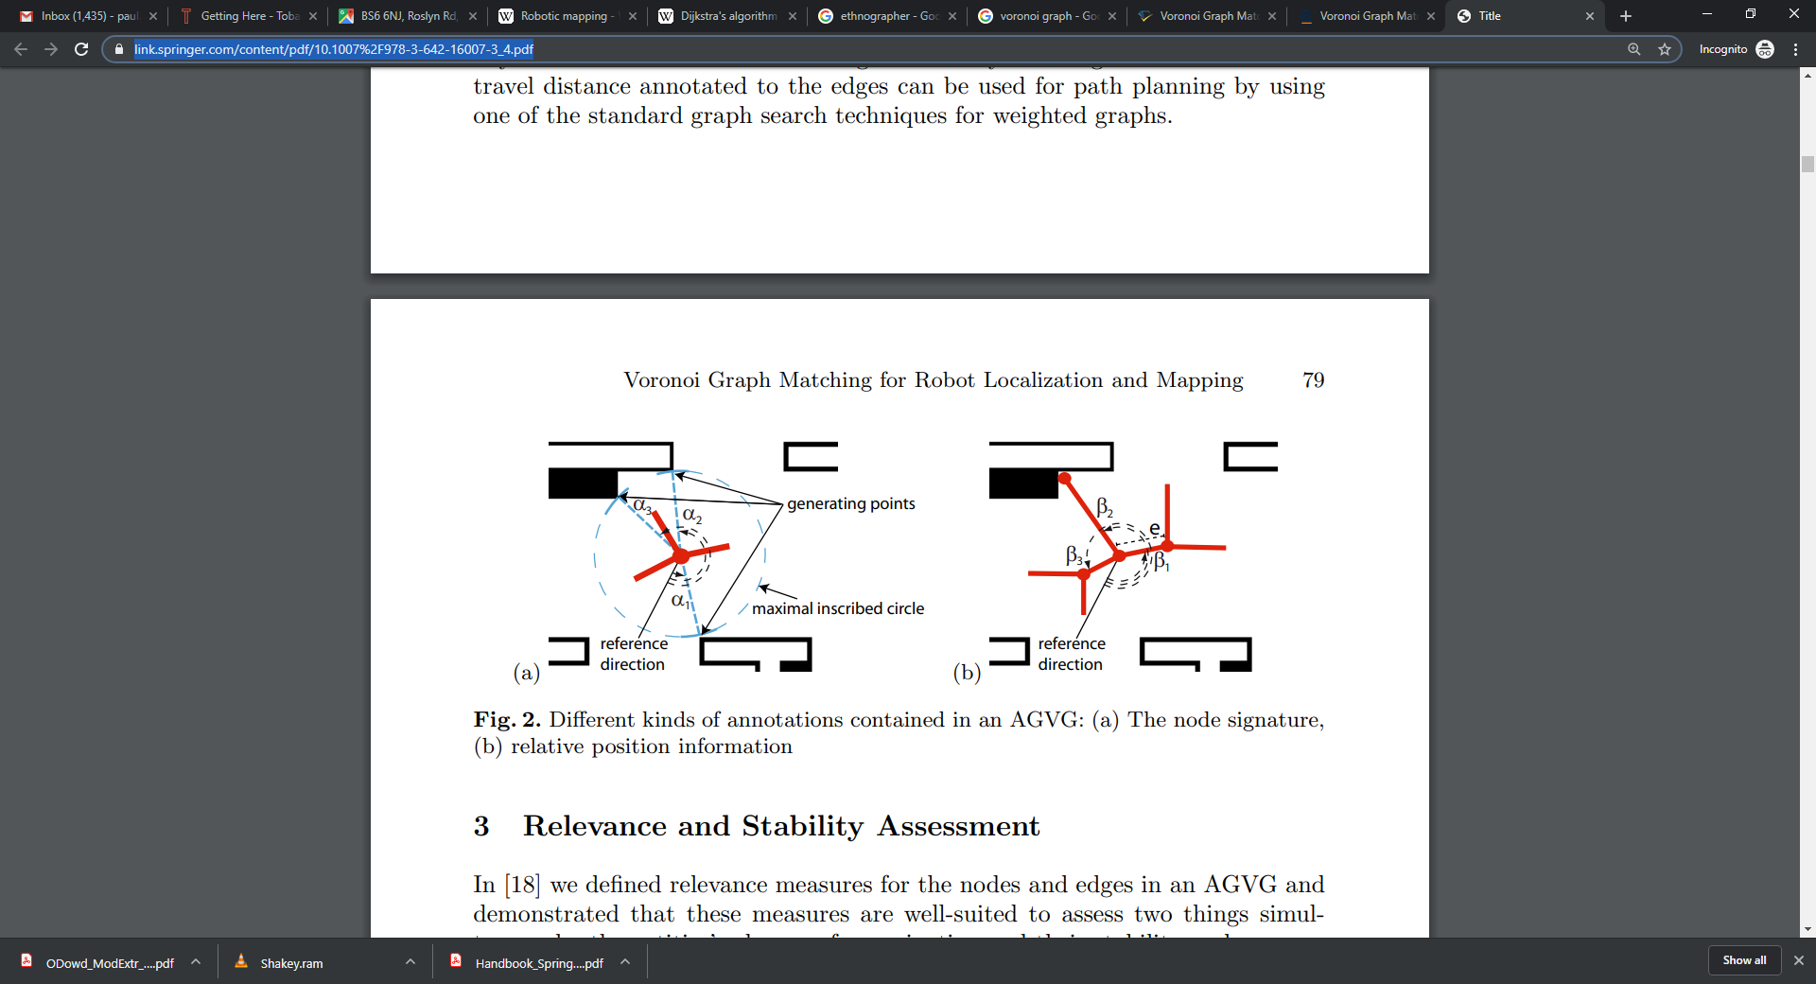
Voronoi Graph
https://link.springer.com/content/pdf/10.1007%2F978-3-642-16007-3_4.pdf

Slide 43
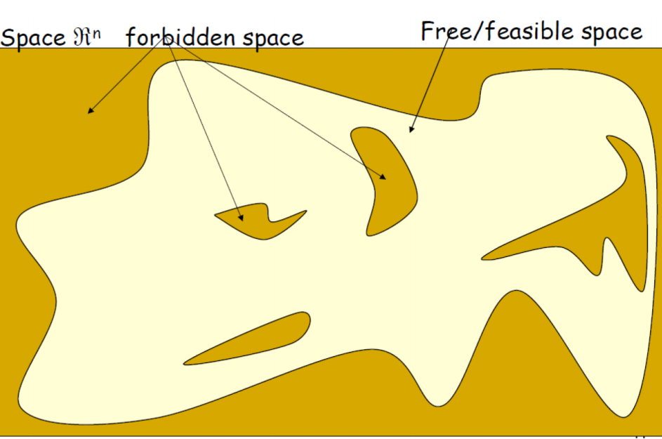
Probabilistic Roadmap

Slide 44
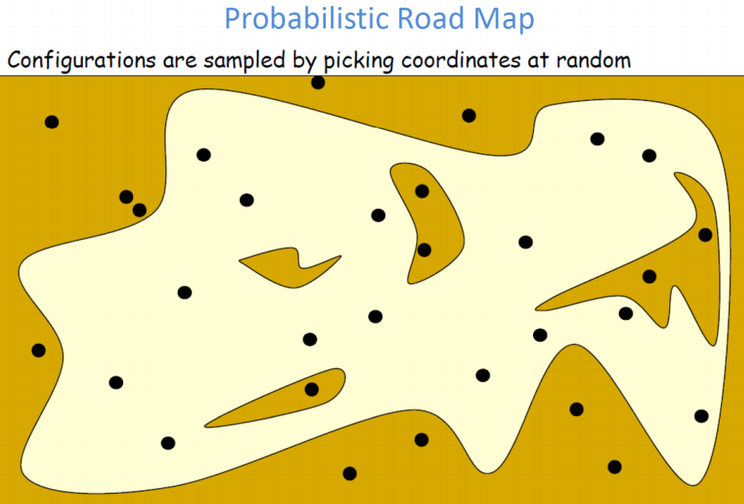
Probabilistic Roadmap

Slide 45
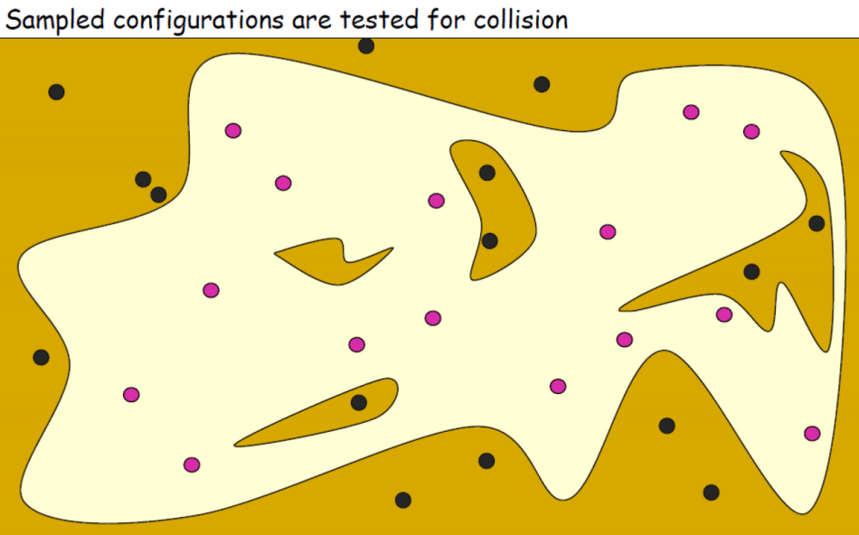
Probabilistic Roadmap

Slide 46
Probabilistic Roadmap

Slide 47
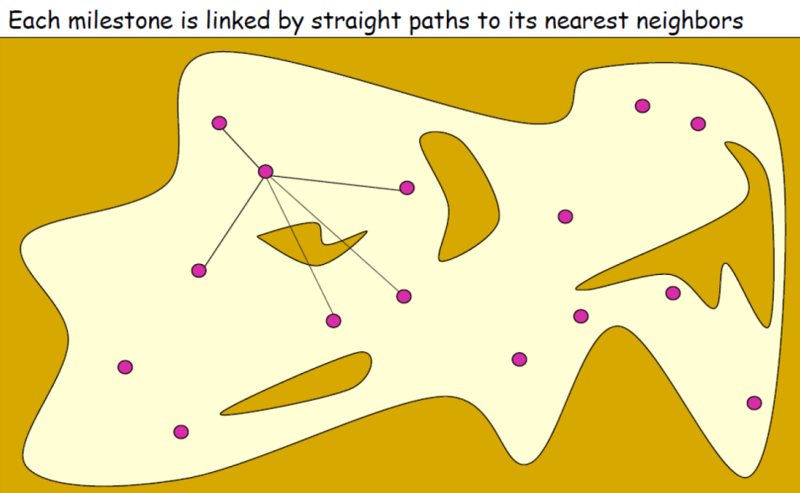
Probabilistic Roadmap

Slide 48
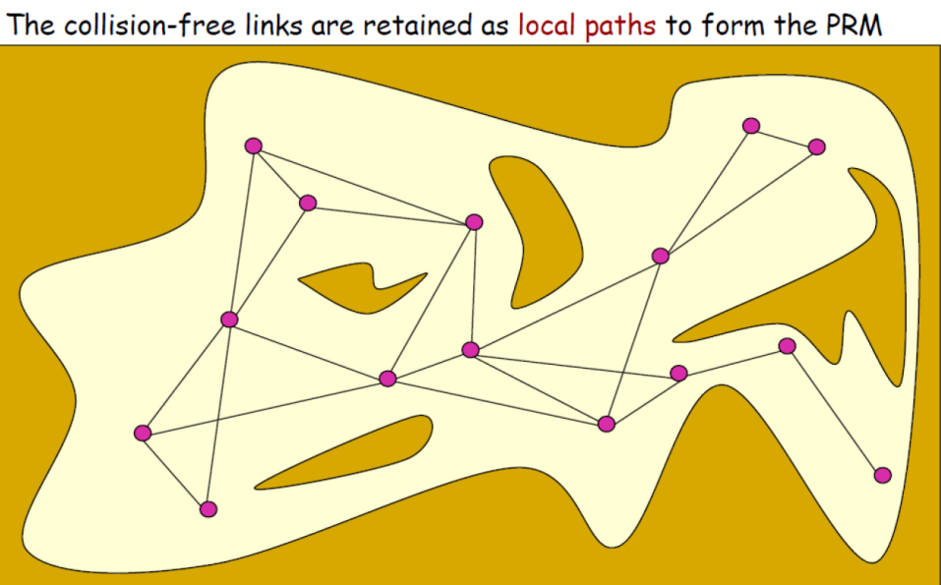
Probabilistic Roadmap

Slide 49
Probabilistic Roadmap

Slide 50

Rapidly Exploring Random Tree (RRT)

Slide 51
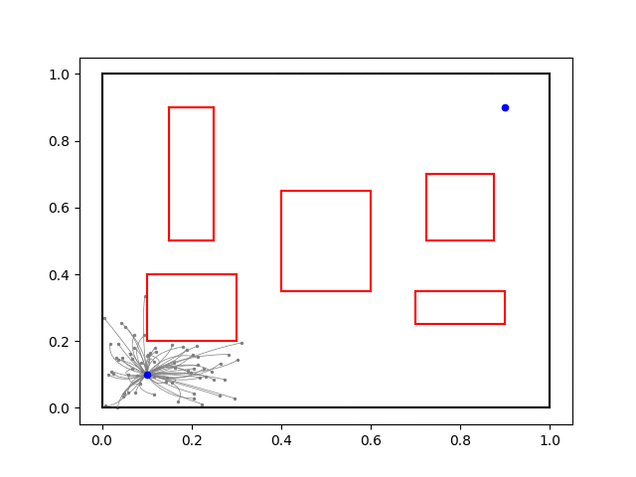
Rapidly Exploring Random Tree (RRT)

Slide 52
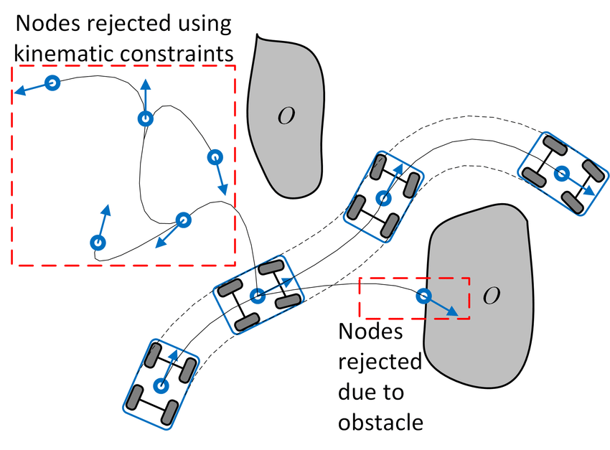
Rapidly Exploring Random Tree (RRT)

Slide 53
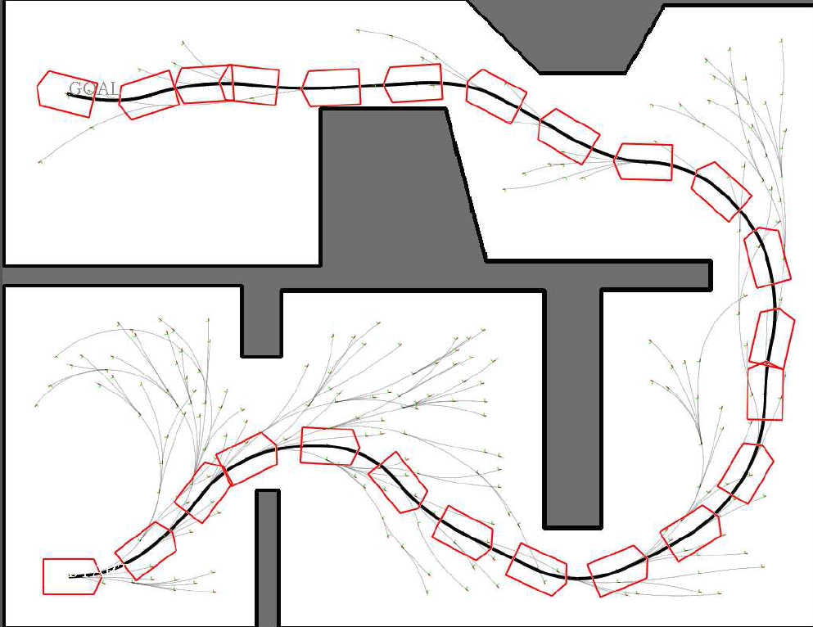
Rapidly Exploring Random Tree (RRT)

Slide 54
This Lecture: Path Planning
Experiment within the theme of Mapping
Configuration Space / Working Space
Grids vs. Graphs
Grids
Graphs

Slide 55
Discussion / Q+A

